Slide 1
Hack Proofing your Modern Web Apps
Adam Tuliper
adamt@microsoft.com

Slide 2

About this guy
Adam Tuliper
Principal Software Engineer @ Microsoft
20+ year software architect
Cloud, gaming & mixed reality, web, bots
Orange County Unity Meetup
Security background
ASM should be taught to everyone ☺
adamt@microsoft.com | @AdamTuliper
adamtuliper.com

Slide 3
Introduction
TODO:
Open
http://www.cvedetails.com/vulnerabilities-by-types.php
https://www.owasp.org/index.php/Top_10_2017-Top_10
https://medium.com/node-security/the-most-common-xss-vulnerability-in-react-js-applications-2bdffbcc1fa0
https://content-security-policy.com/

Slide 4
Goals
Learn about several common attack types
Demo how the attack works
We’re using MVC & Web Forms.
All of these attacks apply to nearly ALL web frameworks.
No – jQuery doesn’t make you safe.
No – Angular doesn’t make you safe
Fix our application
It’s not an exhaustive list – it’s an intro. Keep learning!
Current
http://www.cvedetails.com/vulnerabilities-by-types.php
Notes:
No Script kiddies!!
Let’s explore https://www.owasp.org/index.php/Top_10_2017-Top_10
React
https://medium.com/node-security/the-most-common-xss-vulnerability-in-react-js-applications-2bdffbcc1fa0

Slide 5
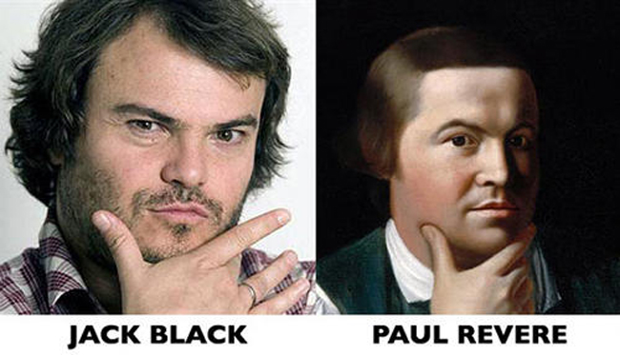
Before we begin… social engineering

Slide 6



Scanner
My company uses scanners – I’m ok
Notes:
https://www.mcafeesecure.com/verify?host=acehardware.com

Slide 7

True Story
I uncovered a hack at a company I worked at in NJ on a server
You’ll never believe what happened next……….
Notes:
https://www.mcafeesecure.com/verify?host=acehardware.com

Slide 8
Does being ‘verified’ mean…..
Free from code issues?
No SQL Injection in the database?
No existing bad data in the database?
No custom backdoors?
Tokens generated for CSRF prevention?
All input fields sanitizing data server side?
No information leakage?
Credentials are protecting all of your information?
Notes:
https://www.mcafeesecure.com/verify?host=acehardware.com

Slide 9
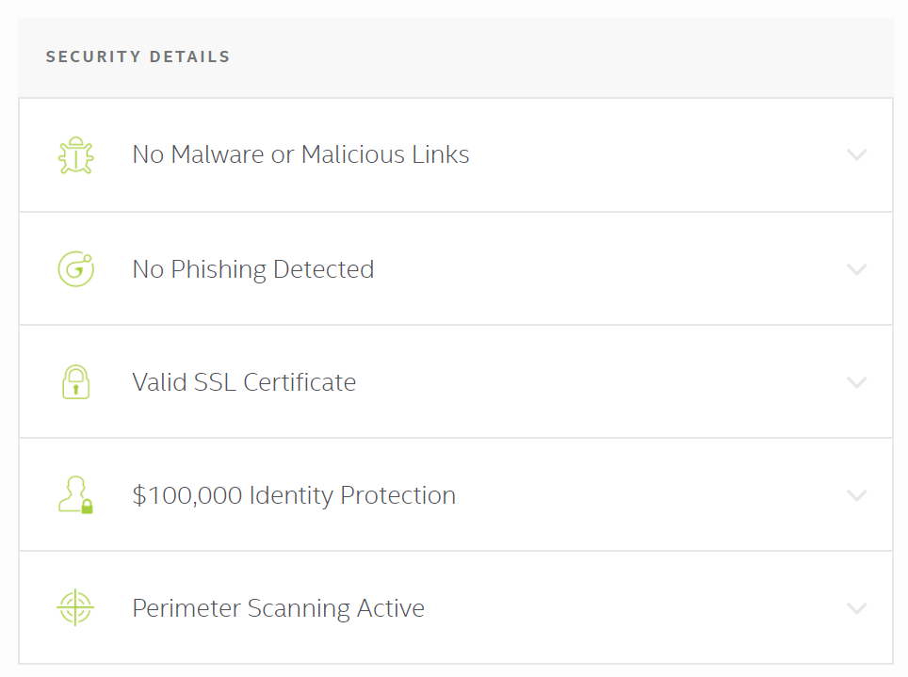
Scanner
Notes:
https://www.mcafeesecure.com/verify?host=acehardware.com

Slide 10
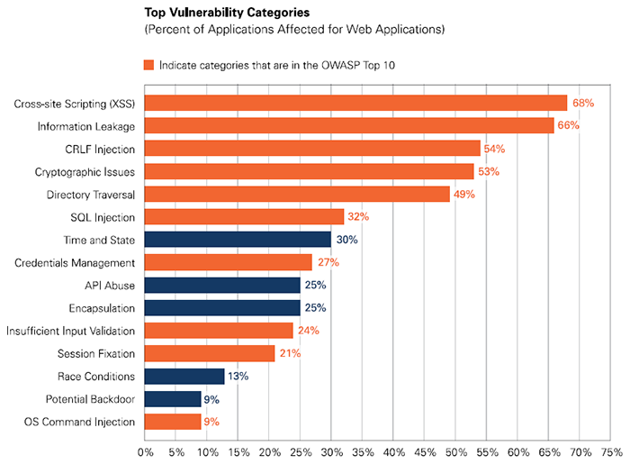

Slide 11
JavaScript Frameworks?
Are you safe using jQuery, Angular, etc?
Ex: https://code.google.com/archive/p/mustache-security/wikis/AngularJS.wiki
Note some of the common attacks
Frameworks can be abused – research yours
Angular Templates – precompiling? Dynamic?
Dynamic templates do have an injection risk

Slide 12
SQL Injection Cross Site Scripting Cross Site Request Forgery Information Leakage Encryption
Select * from pwned
The fastest way into your systems

Slide 13

SQL Injection - What is it?
Control code injected into the data channel
Values are altered to create SQL commands where only data is expected
Dangerous?
Network enumeration
Account creating/cracking
Database Copying over port 80
Data Tampering
Code Download
Backdoors
Expected Input
Unexpected Input
Notes:
Demos on the next page

Slide 14
How Is It Exploited?
URI tampering
Parameter Tampering
Cookie Tampering
Set-Cookie: DefaultSearchLanguage=EN-US' union x,x,x--; path=/;
Notes:
Reviewer notes – demos are against the project: Security-Asp.Net app page /productsearch.aspx
Note a simple ' will cause an error
we see three fields returned, so we need at least three fields.
~ Enable custom error handler. Now that we see ‘some error’ is returned lets find out if we are exploitable.
~ Blind Injection Timing attack
'; WAITFOR DELAY '0:0:5' –
~ ' union select '1','1','1‘--
~ tables: XXX' union select name, '1', '1' from sysobjects where type='u' –
~get all columns XXX' union select sc.name, so.name, '1' from syscolumns sc inner join sysobjects so on sc.id=so.id where so.type='u' order by 2—
~get credit card XXX' union select DefaultCreditCardNumber, Name , '1' from Customer –
Can easily hide in IIS log files:
;%65%78%65%63%20%4D%41%53%54%45%52..%78%70%5F%63%6D%64%73%68%65%6C%6C%20'mkdir%20%25systemroot%25%5Csystem32%5C

Slide 15
Isn’t This Old?
Yes, 18 years to be exact
Legacy code and new
Still very common
TalkTalk hack
Verizon – 19% of attacks are SQLi
http://www.verizonenterprise.com/DBIR/

Slide 16
SQL Injection
Notes:
Reviewer notes – demos are against the project: Security-Asp.Net app page /productsearch.aspx
Note a simple ' will cause an error
we see three fields returned, so we need at least three fields.
~ Enable custom error handler. Now that we see ‘some error’ is returned lets find out if we are exploitable.
~ Blind Injection Timing attack
'; WAITFOR DELAY '0:0:5' --
~ ' union select '1','1','1'--
~ tables: XXX' union select name, '1', '1' from sysobjects where type='u' --
~get all columns XXX' union select sc.name, so.name, '1' from syscolumns sc inner join sysobjects so on sc.id=so.id where so.type='u' order by 2--
~get credit card XXX' union select DefaultCreditCardNumber, Name , '1' from Customer –
Can easily hide in IIS log files:
;%65%78%65%63%20%4D%41%53%54%45%52..%78%70%5F%63%6D%64%73%68%65%6C%6C%20'mkdir%20%25systemroot%25%5Csystem32%5C

Slide 17
How Do You Prevent It?
ALL calls are parameterized
No dynamic strings
Escape/Whitelist input.
Regex works great for legacy code that is brittle
Regex.Replace(searchText, "[^a-zA-Z0-9 ]", "");
Audit table permissions!
Use an ORM
Entity Framework, etc (Caution of other apps using db)
Notes:
~explain search better, search best in code and differences with param query and stored proc.
Parameterized method is: LoadProductsParameterized();
Proc method is: LoadProductsStoredProc
3. If page values aren’t in list, use default or error. MVC: Route Constraints
Try to avoid SQL functions to escape – unexpected side effects at times
#3. whitelist to keep DB data clean too.
~ Demo whitelisting QUERY input searchText = System.Text.RegularExpressions.Regex.Replace(searchText, "[^a-zA-Z0-9 ]", "");
~ explain whitelisting sortOrder input. Explain EnableRequestValidation=false and if its on, not as much of a concern.
For sortOrder attack - fiddler breakpoint and alter: Asc ; select '1', '1', '1‘
MVC – Must whitelist combo box data on the server side manually – also use route constraints where applicable.
#4 show custom errors turned on.
http://ipv4.fiddler/security/CauseError.aspx
Note: Entity Framework and ORM’S help prevent but can require less restrictive table permissions unless you use only stored procedures. – An alternative is to use procedures for all updates, only select permissions for all other queries.
Auto attached sql express databases (think APP_DATA) generally allow all users to query all tables by default

Slide 18
But I Need My Dynamic SQL!
Usually not – dynamic where clauses with static SQL:
WHERE (CustomerId = @CustomerId OR @CustomerId IS NULL)
Dynamic Order By using RANK
Regex/whitelist everything possible & parameterized queries
Avoid exec instead of sp_executesql because of the lack of parameter support.
Notes:
Two samples below
1. dynamic where clauses without dynamic sql.sql
2. sp_executesql with params.sql maybe using sp_executesql with legacy code?

Slide 19
SQL Injection Misconceptions
I am safe if always using stored procs: FALSE
If I replace only -- and ' I am safe: FALSE
If I have an error page I’m safe: FALSE
Permissions will always protect me: FALSE
Parameterized queries will protect me: *If done correctly
Notes:
1. Dynamic sql in procs can still occur
2. Why? Injecting data into numeric data wouldn’t require – ex: select * from users where customerid = 1 and customerId you inject “1 or customer>0
3. Why? Error pages just give info AFTER the attack.
4. Why? A user (attacker) may have permissions to a customer table by design
5. Parameterized queries still need caution when creating and care must be given to not have dynamic sql embedded in them.

Slide 20
SQL Injection
Cross Site Scripting Cross Site Request Forgery Information Leakage Encryption
When CSS isn’t cool

Slide 21


XSS – What is it?
Script** injected into:
Page, Database, Cookies
Main types – Reflected, Persistent, DOM Based
Access DOM, steal cookies, send form data, and more
**Scriptless attacks don’t require any script
Evil Script
Script Injected to Web Page
User Visits Page
Notes:
IE http://blogs.msdn.com/ie/archive/2008/07/02/ie8-security-part-iv-the-xss-filter.aspx
Ironically, there was a XSS vulnerability caused by this filter
http://en.wikipedia.org/w/index.php?title=Cross-site_scripting&oldid=312565384&foo="/wiki/File:Wikipedesketch1.png"class="image"><img alt=
IE8 Disabled by Header: X-XSS-Protection: 0
Can send data to other domains via iframes, images, and script requests

Slide 22
How Is XSS Exploited?
Page processes malicious data as script***
URIs, Form Fields, Cookies, and Databases all sources of ‘script’
Injected tags
Partial – <img src= '
Full <form>..</form>
Tricky to catch all combinations:
<DIV STYLE="width: expression(alert('XSS'));“>
Without <script> tags
<IMG SRC=javascript:alert(String.fromCharCode(88,83,83))>
<BODY onload=alert('test1')>
Notes:
Problems with filtering: Multi language url support complicates further
~ Demo http://localhost/security/ProductDetails.aspx?id=5
~ Paste in scriptinjection.txt (or see below )
~ IE6 GIF demo

Slide 23
XSS Attack
Notes:
Note, Chrome’s xss protection but it can cause issues
https://www.bmyers.com/public/Bypassing-the-XSS-AUDITOR-error-in-Chrome.cfm

Slide 24
Scriptless Attack
Notes:
http://localhost:5173/scriptless.aspx
http://localhost.fiddler:7671/Xss/Scriptless.aspx in
C:\Users\Adam\Dropbox\Hack proofing code demos\Xss\Before

Slide 25
How Do You Prevent XSS?
HtmlEncode or AttributeEncode all output
@, <%:, HtmlEncode(), HtmlAttributeEncode() ,<#: (4.5)
No dynamic attributes
<div onclick=@Model.SomeField >
Avoid WebForm’s ValidateRequest=false
WYSIWYG Editing or HTML
Encode before POST
MVC3+ - [AllowHtml] on Model Property
Avoid [ValidateInput(false)]
ASP.Net 4 <httpRuntime encoderType>
Use Anti-Xss! Included in 4.5!!!
Notes:
Look at:
http://www.c-sharpcorner.com/UploadFile/sourabh_mishra1/validate-input-in-Asp-Net-mvc/
*Try not to allow dynamic attributes. Ex. <body onload={some output value} >
~1. fix output at: http://localhost/security/productdetails.aspx?id=5 with Server.HtmlEncode((string))
~2. show <s on http://localhost/security/productsearch.aspx explain request validation.
~5 Anti-Xss Nothing ‘broke’ with html encode – whitelisting is better
HTML Encode only is concerned with keeping html compatibility. As such it only encodes certain characters.
Anti-XSS whitelists some characters, and encodes everything else, and understands more than just english.
~5 show new encoder overriding in web.config, explain implemented with <httpRuntime in .net 4 – discuss using antixss encoder.
New to .net 4, ability to specify the encoder. Show Web.config in Security-Asp.Net
The OWASP project Anti-SAMY is also a good project and has templates that you can control how restrictive it is.

Slide 26
Preventing XSS - Additional
Should you store data encoded?
Not encoded, but sanitized.
< &lt; &amp;lt; &amp;amp;let
AngleSharp w/HtmlSanitizer or HTML Agility Pack
jQuery .html() vs .text()
Test controls - inject script, special characters.
Audit all areas data is dynamically displayed <%, <%#...
Notes:
nuget.org/packages/HtmlAgilityPack
Or
https://github.com/mganss/HtmlSanitizer
Which is Install-Package HtmlSanitizer -Version 3.4.156
Demo:
http://localhost:5173/productdetails.aspx?id=5
//Now use the HTML Agility pack
//comment.Comment = HtmlSanitizer.Sanitize(txtComments.Text);
comment.Comment = txtComments.Text;
http://localhost:5173/displaydata.aspx
Check encoding charts - know your control’s encoding behavior!
Lookup control encoding - Ex. LiteralControl does not encode, TextBox does, Label does not.
~demo http://localhost/security/displaydata.aspx
Test by injecting:
<script>alert('xss')</script>some more content
~ Fix ProductDetails.aspx.cs to additionally use Sanitizer.GetSafeHtmlFragment(txtData.Text) on btnSave

Slide 27
Sanitizing Data
Notes:
http://localhost:5173/DisplayData.aspx

Slide 28
XSS - Content Security Policy
Header Content-Security-Policy limits content sources
What can it restrict?
JavaScript, CSS, Frames, Audio, Object, Media, <form> action uri
<script>, <a href="javascript:bad_stuff()">, <a onclick="bad_stuff()">
Allowed
Allow content in files loaded from white-listed sources
Can report non-compliant URLs
http://caniuse.com/#feat=contentsecuritypolicy
Notes:
http://www.w3.org/TR/CSP/
http://blog.mozilla.org/security/2013/06/11/content-security-policy-1-0-lands-in-firefox/
http://content-security-policy.com/
http://caniuse.com/contentsecuritypolicy
Sandbox mode is similar to iframe permissions,
sandboxallow-forms allow-scriptsEnables a sandbox for the requested resource similar to theiframe sandbox attribute. The sandbox applies a same origin policy, prevents popups, plugins and script execution is blocked. You can keep the sandbox value empty to keep all restrictions in place, or add values: allow-formsallow-same-origin allow-scripts, andallow-top-navigation

Slide 29
Content Security Policy - NWebsec
Policies for image, css, and script loading
app.UseCsp(options =>
options.DefaultSources(s => s.Self())
.ScriptSources(s =>
s.Self().CustomSources(
"ajax.aspnetcdn.com", "api.github.com",
"*.twitter.com").UnsafeEval())
.StyleSources(s =>
s.Self().CustomSources("platform.twitter.com").UnsafeInline())
.ImageSources(s => s.CustomSources("*", "data:"))
.FrameSources(s => s.CustomSources("*.twitter.com",
"*.youtube.com"))
.ObjectSources(s => s.CustomSources("*.youtube.com")));
Notes:
Object-src Specifies valid sources for the <object>, <embed>, and <applet> elements.
NWebSec - nuget
https://www.nuget.org/packages/NWebsec.Core/

Slide 30
Content Security Policy
Notes:
http://localhost:5173/ContentSecurityPolicy.aspx
http://caniuse.com/#feat=contentsecuritypolicy
Note on page:
<script>alert('xss')</script>
https://www.owasp.org/index.php/Content_Security_Policy
Chrome won’t execute this, basic built in protections.
//This reports
Response.AddHeader("Content-Security-Policy-Report-Only",
"script-src self report-uri /csp-report-endpoint/");
Response.AddHeader("Content-Security-Policy-Report-Only", "script-src self report-uri /csp-report-endpoint/");

Slide 31
SQL Injection
Cross Site Scripting Cross Site Request Forgery Information Leakage Encryption
Forgery makes developers unhappy ☹

Slide 32
CSRF – What Is It?
Attacker piggybacks on victim’s auth
Attacker gets user to execute
Can be very simple
Image tag in an email
Script on a blog
Identifying the attacker can be difficult
Notes:
Hit twitter in 2010 and posted obscene items
-– difficult to track down attacker - your IIS logs will be for the authenticated ‘real’ user
<script type="text/javascript">
var el1 = document.createElement('iframe');
var el2 = document.createElement('iframe');
el1.style.visibility="hidden";
el2.style.visibility="hidden";
el1.src = "http://twitter.com/share/update?status=WTF:%20" + window.location;
el2.src = "http://twitter.com/share/update?status=i%20love%20ronchy%20stuff";
document.getElementsByTagName("body")[0].appendChild(el1);
document.getElementsByTagName("body")[0].appendChild(el2);
</script>

Slide 33
CSRF – How Is It Exploited?
Requests are generally repeatable
Image - can be embedded in an email <img src="http://host/CreateUser?JaneDoe">
Attacked via XSS <script src="http://host/CreateUser?JaneDoe">
<iframe src="http://host/CreateUser?JaneDoe">
Invisible actions via the 'Image' Object var foo = new Image(); foo.src = "http://host/CreateUser?JaneDoe";
Notes:
GET request exploit:
~Explain simple link for deleteuser and how it just ‘deletes’ without prompting.
http://ipv4.fiddler/security/admin/deleteuser.aspx?id=41 (41+)
Even posting can be hacked: Replay exploit
~Run fiddler request and post some details for http://localhost:5178/User/7 (ensure you launch MVC app)
It succeeds.
Repost in fiddler – it succeeds.
The point here is requests can be replayed. Its trivial to form a post request via ‘evil script’
~paste below script into: http://ipv4.fiddler/security/productdetails.aspx?id=5
Show in fiddler
<script type="text/javascript">
var el1 = document.createElement('iframe');
el1.style.visibility="hidden";
el1.src = "http://ipv4.fiddler/security/admin/deleteuser.aspx?id=40";
document.getElementsByTagName("body")[0].appendChild(el1);
</script>

Slide 34
CSRF – Email attack
Notes:
https://mail.google.com/mail/u/0/#search/Best.Book.Deal.Ever.
SET IDENTITY_INSERT dbo.[user] ON;
insert into [user] (userid,username,password) values(128,'DEVintersection', '12345')

Slide 35
Preventing CSRF
Modification through POST only
GET requests should not change state
Part of HTTP SPEC
Prevent repeatable POSTS
Create unique hidden form token
Token required on POST
Notes:
More details on next slide for prevention.
~part 1 of fix: deleteuser.aspx - make the action happen through a post – enable the button click code and change page_load.
http://ipv4.fiddler/security/admin/deleteuser.aspx?id=4
(part 2 in oneclick)
Explain this is not complete yet.

Slide 36
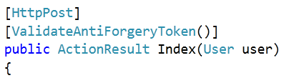
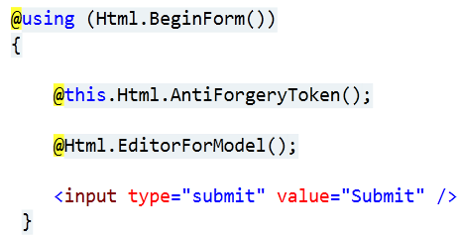
Preventing CSRF - MVC
Use [HttpPost]
Use Anti-forgery tokens
Uses both form token and cookie
Notes:
FIX:
~Add token to view: <%: this.Html.AntiForgeryToken()%> C:\source\Demos\Security\Security-MVC\Views\User\Index.aspx
~Add [ValidateAntiForgeryToken()] to C:\source\Demos\Security\Security-MVC\Controllers\UserController.cs
Show cookie and form value in fiddler for antiforgerytoken
Now try to repeat the request in fiddler.

Slide 37
Preventing CSRF – Web Forms
“Sign” the view state with a session key
ViewStateUserKey = SessionId
Do not turn off EnableViewStateMac=true
Notes:
FIX:
~Add token to view: <%: this.Html.AntiForgeryToken()%> C:\source\Demos\Security\Security-MVC\Views\User\Index.aspx
~Add [ValidateAntiForgeryToken()] to C:\source\Demos\Security\Security-MVC\Controllers\UserController.cs
Show cookie and form value in fiddler for antiforgerytoken
Now try to repeat the request in fiddler.

Slide 38
Hi, I’m The One-Click Attack
Web Forms Assumptions*
Button commands only processed on post
ViewState only processed on post
Page.IsPostBack always means post
*(all of the above are false)

Slide 39
One Click Attack
Notes:
http://localhost:5173/Admin/AddUser.aspx
https://images-na.ssl-images-amazon.com/images/I/414zEER9GmL._UY250_.jpg

Slide 40
SQL Injection
Cross Site Scripting Cross Site Request Forgery Parameter Tampering Information Leakage Encryption
Taking advantage of page trust

Slide 41
Parameter Tampering
Simple attack
Change parameters
URL, Form fields, Cookies

Slide 42
Parameter Tampering
Notes:
http://localhost:5178/User/7
Explain - hidden key value =7 on the page, before posting, breakpoint in fiddler and change the value to 1, assuming this is the admin id.
Show admin password in database
Change to “SystemError” on the name
Set fiddler to breakpoint before request.
http://localhost/SecurityMVC/User/7
Change ID to 1. Finish request. Show Database.

Slide 43
Preventing Tampering
Validate data on server
Ex. don’t trust primary key user passes in - validate
Web Forms – Built in protection!
EnableEventValidation protects Hidden textbox
Protection often disabled because of validation issues
Web Farm Considerations
Notes:
Relies (usually) on overriding hidden primary keys
~ Demo - Change administrator information
http://localhost/SecurityMVC/User/7
Show database for userid 7, Show hidden value, change and replay in fiddler
WebForms
Solution: DO NOT turn off EnableEventValidation – If javascript alters a field, tell WebForms to allow certain values:
Page.ClientScript.RegisterForEventValidation(this.UniqueID, "1000");
~Fix:
Web Forms – do not disable EventValidation!! It will apply to ALL textboxes and comboboxes. Data cannot be changed.
MVC ViewStateish:
View: @Html.AntiModelInjectionFor(o => o.CustomerId)
Controller: [ValidateAntiModelInjectionAttribute("CustomerId")]
Scott Allen has a great post on this:
If javascript for ex. adds a value, then you need to RegisterForEventValidation() to give it a valid value. There is no way to de-register a control from this. You need your own custom control : (
http://odetocode.com/blogs/scott/archive/2006/03/20/asp-net-event-validation-and-invalid-callback-or-postback-argument.aspx
http://odetocode.com/blogs/scott/archive/2006/03/21/asp-net-event-validation-and-invalid-callback-or-postback-argument-again.aspx
DANGER!!
http://muruganad.com/ASP.NET/Invalid-postback-or-callback-argument.--Event-validation-is-enabled-using-pages-enableEventValidationtrue.html

Slide 44
SQL Injection
Cross Site Scripting Cross Site Request Forgery Encryption
Information Leakage
Taking advantage of page trust

Slide 45
Encryption
Hash or Encrypt ALL Passwords
SHA256/SHA512 with salt
aspnet_regiis.exe -pe "connectionStrings" -app "/yourapp"
Encrypt AFTER deployment to avoid machine key issues
May need to add permissions for key container via:
aspnet_regiis -pa "NT AUTHORITY\NETWORK SERVICE”
ASP.NET Core uses IDataProtectionProvider
Notes:
Membership provider can be configured to hash both SHA256 and SHA512
Additional Code Demos for download
http://ipv4.fiddler/security/Admin/AddUser.aspx allow hashpwd
http://docs.asp.net/en/latest/security/data-protection/consumer-apis/overview.html

Slide 46
Protecting Credentials
ALL pages use SSL (Intranet too)
Basic Auth, Forms Auth, NTLM, Cookies
Use HttpOnly cookies and SSL on every page to protect transport layer
Forms authentication requireSSL
Doesn’t actually force SSL
No session info in the URL
Session Hijacking only takes one cookie value
USE HTTP Strict Transport Security (HSTS)
Notes:
Containing session information on the url can lead to easy access via script and browser history.
Note requireSSL does not ‘force’ ssl it only sends token if the page is viewed over ssl!!
Session info on url can be extracted by scripts and stay in the history.

Slide 47
Strict Transport Security
Strict-Transport-Security: max-age=31536000
Does not allow user to override invalid cert msg
Browser automatically changes to https
Add header in IIS
Notes:
http://caniuse.com/#feat=stricttransportsecurity

Slide 48
Strict Transport Security
Notes:
http://caniuse.com/#feat=stricttransportsecurity
https://www.owasp.org/index.php/HTTP_Strict_Transport_Security
See facebook headers – try to access facebook.com, note in fiddler the https
GET https://www.facebook.com/ HTTP/1.1
Host: www.facebook.com
Connection: keep-alive
Accept: text/html,application/xhtml+xml,application/xml;q=0.9,image/webp,*/*;q=0.8
Upgrade-Insecure-Requests: 1
User-Agent: Mozilla/5.0 (Windows NT 10.0; WOW64) AppleWebKit/537.36 (KHTML, like Gecko) Chrome/50.0.2661.102 Safari/537.36
DNT: 1
Accept-Encoding: gzip, deflate, sdch
Accept-Language: en-US,en;q=0.8
Cookie: datr=93Y5V1O4x-nbFl1cb2msXfka; pl=n; lu=ghGqLGcF-73mr3NVEhdOczCg; c_user=616122333; fr=0c1GUfKpjYmuB4807.AWUL5kNAKUhUoXp2f1hDTt-1zHk.BXOXb6.V4.AAA.0.0.AWVGoEV1; xs=126%3AsKafKG5s_a-2yQ%3A2%3A1463383801%3A18040; csm=2; s=Aa7FOpYgxxZuOQqR.BXOXb6; sb=-XY5VwkKscrg79P7dMehjscB
HTTP/1.1 200 OK
P3P: CP="Facebook does not have a P3P policy. Learn why here: http://fb.me/p3p"
X-Frame-Options: DENY
X-XSS-Protection: 0
X-Content-Type-Options: nosniff
Public-Key-Pins-Report-Only: max-age=500; pin-sha256="WoiWRyIOVNa9ihaBciRSC7XHjliYS9VwUGOIud4PB18="; pin-sha256="r/mIkG3eEpVdm+u/ko/cwxzOMo1bk4TyHIlByibiA5E="; pin-sha256="q4PO2G2cbkZhZ82+JgmRUyGMoAeozA+BSXVXQWB8XWQ="; report-uri="http://reports.fb.com/hpkp/"
Pragma: no-cache
Content-Security-Policy: default-src * data: blob:;script-src *.facebook.com *.fbcdn.net *.facebook.net *.google-analytics.com *.virtualearth.net *.google.com 127.0.0.1:* *.spotilocal.com:* 'unsafe-inline' 'unsafe-eval' fbstatic-a.akamaihd.net fbcdn-static-b-a.akamaihd.net *.atlassolutions.com blob: chrome-extension://lifbcibllhkdhoafpjfnlhfpfgnpldfl;style-src * 'unsafe-inline' data:;connect-src *.facebook.com *.fbcdn.net *.facebook.net *.spotilocal.com:* *.akamaihd.net wss://*.facebook.com:* https://fb.scanandcleanlocal.com:* *.atlassolutions.com attachment.fbsbx.com ws://localhost:* blob: 127.0.0.1:*;
Cache-Control: private, no-cache, no-store, must-revalidate
Expires: Sat, 01 Jan 2000 00:00:00 GMT
Strict-Transport-Security: max-age=15552000; preload
Vary: Accept-Encoding
Content-Type: text/html
X-FB-Debug: 0U2aHTnCjzm6qSjCRwsDugeoC0070Fgc/HR0oTepR/xxe8/oNi1y0V1dHOhAgYOQSkvxyp6vA7RInwsA+RGm1Q==
Date: Wed, 18 May 2016 07:58:50 GMT
Connection: keep-alive
Content-Length: 453499

Slide 49
SQL Injection Cross Site Scripting Cross Site Request Forgery Encryption
Information Leakage
Captain – She’s sprung a leak!!!!!

Slide 50
Information Leakage
Implement <customErrors>
Test various types of errors (404, 500, etc)
Ensure ALL tracing is disabled
Disable all page level tracing
Search for tracing in web.config
Try accessing trace.axd
Use Retail Mode
Edit C:\Windows\Microsoft.NET\Framework\v4.0.30319\Config\machine.config
Notes:
https://msdn.microsoft.com/en-us/library/ms228298(v=vs.100).aspx
https://www.bing.com/search?q=Trace+Information+++++Begin+PreInit+login+password&go=Submit&qs=n&form=QBRE&pq=trace+information+begin+preinit+login+passwor&sc=0-0&sp=-1&sk=&cvid=99F8967808A44F88BCC0E3897FA7CB2B
In C:\Windows\Microsoft.NET\Framework\v4.0.30319\Config\machine.config
<system.web>
<deployment retail="true" />
Retail mode will turn off debug compilation & tracing and turn on custom errors.
~ 1. show page and code http://localhost/Security/CauseError.aspx
Important to test 404 as 404 errors aren’t always handled if not in integrated mode for asp.net
~3.
They are EVERYWHERE – bing it
Trace Information Begin PreInit
Trace Information Begin PreInit login
<!--deployment retail="true"/ -->

Slide 51
Summary
Most attacks are simple
Attacks can be compounded
CSS & CSRF
JavaScript frameworks do not inherently protect you
You must audit your apps

Slide 52
Additional References
Note the URLs in the various slides for testing / reference
https://github.com/mganss/HtmlSanitizer
https://angular.io/docs/ts/latest/guide/security.html
https://www.owasp.org/index.php/HTTP_Strict_Transport_Security
https://developer.mozilla.org/en-US/docs/Web/Security/HTTP_strict_transport_security
Hack-proofing @ Pluralsight
http://bit.ly/HackProofing
Retail Mode
https://msdn.microsoft.com/en-us/library/ms228298(VS.80).aspx

Slide 53
Questions?
Please use Events XD (EventBoard) to fill out a session evaluation.
Thank you!
@AdamTuliper
adamt@microsoft.com

